Slide 1
Chemistry – Jan 14, 2020
P3 Challenge-
  What are the quantum numbers for the first electron in a 3p subshell?
Today’s Objective –
  Electron Configurations (Get out your colored periodic table)
Get out Quantum Numbers Worksheet for Hmk Check

Slide 2
Chemistry – Jan 14, 2020
Objective –
  Electron Configurations
Agenda
  Homework Review
  Electron filling rules (3)
  Energy levels with the Periodic table
  Electron configuration notation
  Writing Electron configurations (complete)
  Electron configurations (noble gas)
  Ion electron configurations
Assignment: Electron Configurations Worksheet

Slide 3
Homework Review
1. Sketches:
  A) Circle B) Figure 8 C) Double pacifier, figure 8 with donut D) Four lobe clover
2. , the angular momentum quantum number
3.
n | Possible values | Possible subshell labels
1 | 0 | s
2 | 0, 1 | s, p
3 | 0, 1, 2 | s, p, d
4,5… | 0, 1, 2, 3 | s, p, d, f

Slide 4
Homework Review
4. and 5.
6. a) 8e 2s, 2p_{x}, 2p_{y}, 2p_{z} b) 6e 3p_{x}, 3p_{y}, 3p_{z}
c) 2e 4s d) 10e 4d_{yz}, 4d_{xy}, 4d_{xz}, 4d_{x2-y2}, 4d_{z2}
7. a) is prohibited. Because for n=1, can only be 0 for an s orbital.
c) is prohibited. Because cannot be negative. b) d) and e) correct
 | Possible m_{l} values | # of m_{l} values | # of orbitals | Max # of e
0, s | 0 | 1 | 1 | 2
1, p | -1, 0, 1 | 3 | 3 | 6
2, d | -2, -1, 0, 1, 2 | 5 | 5 | 10
3, f | -3, -2, -1, 0, 1, 2, 3 | 7 | 7 | 14

Slide 5
How Electrons Fill the Orbitals – the rules
The orbitals are present on every atom, but only some have electrons located in them depending on how many electrons the atom has.
Three guiding principles to use:
1) Aufbau Principle: Electrons live in the lowest energy orbitals possible. (Higher energy orbitals remain empty.) “Aufbau” is German for construction.
2) Pauli Exclusion principle: No two electrons can have the same 4 quantum numbers. Orbitals can hold up to 2 electrons with opposite spins.
3) Hund’s Rule: (Seats on a Bus rule) Electrons will fill orbitals of a subshell singly before pairing up. If paired, they have opposite spins.

Slide 6
Orbital Energy Levels
Energy levels are not intuitive because of the energy levels of the shells overlap as we discovered in the exploration activity.
Order of filling:
1s…2s, 2p…3s, 3p….
Then the shells start to overlap.
…4s, 3d, 4p…5s, 4d, 5p…
…6s, 4f, 5d, 6p…7s, 5f, 6d, 7p
If that seems hard to remember, try this…

Slide 7
 | s | p | d | f
1 | 1s
2 | 2s | 2p
3 | 3s | 3p | 3d
4 | 4s | 4p | 4d | 4f
5 | 5s | 5p | 5d | 5f
6 | 6s | 6p | 6d
7 | 7s | 7p

Slide 8
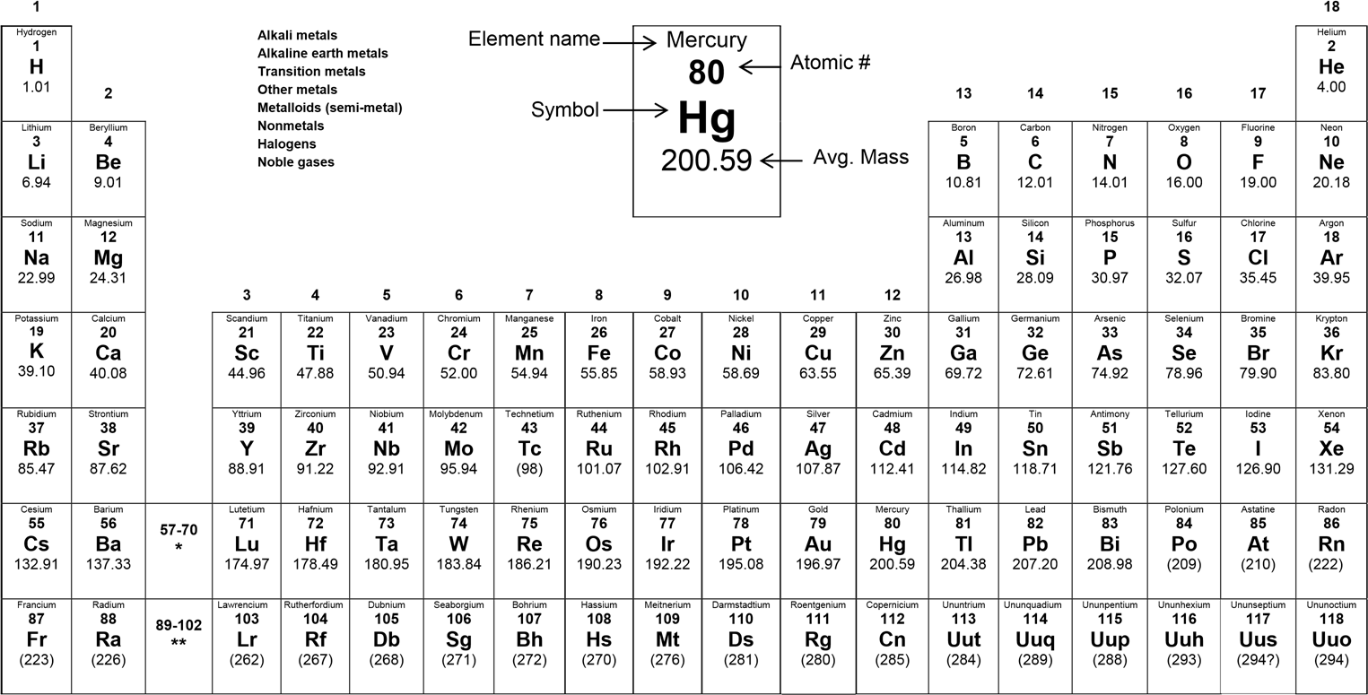
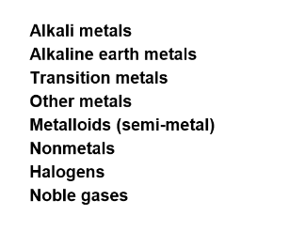

Shells 1-7
  Periods
S block
  1 – 2
  H = 1s
P block
  13-18
  B = 2p
D block
  3-12
  Sc = 3d
F block
  Lanthanides
  Actinides
  La = 4f
Lanthanum 57 La 138.91 | Cerium 58 Ce 140.12 | Praseodymium 59 Pr 140.91 | Neodymium 60 Nd 144.24 | Promethium 61 Pm (145) | Samarium 62 Sm 150.36 | Europium 63 Eu 151.97 | Gadolinium 64 Gd 157.25 | Terbium 65 Tb 158.93 | Dysprosium 66 Dy 162.50 | Holmium 67 Ho 164.93 | Erbium 68 Er 167.26 | Thulium 69 Tm 168.93 | Ytterbium 70 Yb 173.04
Actinium 89 Ac (227) | Thorium 90 Th 232.04 | Protactinium 91 Pa 231.04 | Uranium 92 U 238.03 | Neptunium 93 Np (237) | Plutonium 94 Pu (244) | Americium 95 Am (243) | Curium 96 Cm (247) | Berkelium 97 Bk (247) | Californium 98 Cf (251) | Einsteinium 99 Es (252) | Fermium 100 Fm (257) | Mendelevium 101 Md (258) | Nobelium 102 No (259)
*lanthanides
**actinides

Slide 9
Electron Configurations
An electron configuration shows the distribution of all electrons in an atom.
Each term of a configuration consists of
  A number denoting the energy level, n
  A letter denoting the type of subshell
  A superscript denoting the number of electrons in that subshell.
Maximum superscript values
  s → 2 p → 6 d → 10 f → 14
4p⁵
4p⁵
4p⁵

Slide 10
Writing Electron Configurations
List the subshells in the order they are filled.
Place an exponent to represent the number of electrons filling that subshell.
BEWARE: The maximum exponents possible are:
  s², p⁶, d ¹⁰, and f ¹⁴

Slide 11
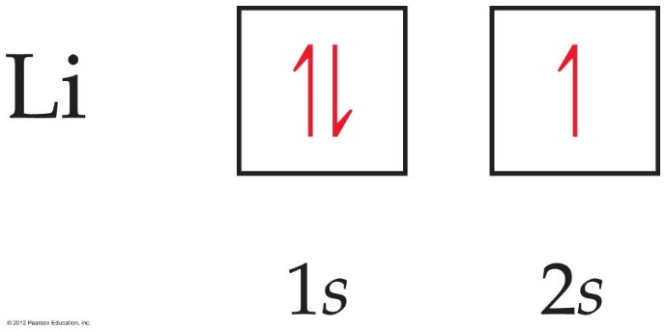
Orbital Diagrams
Each box in the diagram represents one orbital.
Half-arrows represent the electrons. (You may also use full arrows.)
The direction of the arrow represents the relative spin of the electron.
When drawn by hand, often the orbitals are represented by a blank line with the orbital label below and the arrow electrons above.

Slide 12
Some Examples
Hydrogen, H Z=1 1s¹
Helium, He Z=2 1s²
Lithium, Li Z=3 1s²2s¹
Beryllium, Be Z=4 1s²2s²
Boron, B Z=5 1s²2s²2p¹
Carbon, C Z=6 1s²2s²2p²
Nitrogen, N Z=7 1s²2s²2p³
Oxygen, O Z=8 1s²2s²2p⁴
Fluorine, F Z=9 1s²2s²2p⁵
Neon, Ne Z=10 1s²2s²2p⁶

Slide 13
More Examples
Sodium, Na Z=11 1s²2s²2p⁶3s¹
Magnesium, Mg Z=12 1s²2s²2p⁶3s²
Aluminum, Al Z=13 1s²2s²2p⁶3s²3p¹
Silicon, Si Z=14 1s²2s²2p⁶3s²3p²
Phosphorus, P Z=15 1s²2s²2p⁶3s²3p³
Sulfur, S Z=16 1s²2s²2p⁶3s²3p⁴
Chlorine, Cl Z=17 1s²2s²2p⁶3s²3p⁵
Argon, Ar Z=18 1s²2s²2p⁶3s²3p⁶
Potassium, K Z=19 1s²2s²2p⁶3s²3p⁶4s¹
Calcium, Ca Z=20 1s²2s²2p⁶3s²3p⁶4s²

Slide 14
Large Z Elements:
Noble Gas Configuration
Arsenic, As Z=33
  1s²2s²2p⁶3s²3p⁶4s²3d¹⁰4p³
Silver, Ag Z=47
  1s²2s²2p⁶3s²3p⁶4s²3d¹⁰4p⁶5s²4d ⁹
  Or…[Kr]5s²4d ⁹ Abbreviated Electron configuration.
Radon, Rn Z=86
1s²2s²2p⁶3s²3p⁶4s²3d¹⁰4p⁶5s²4d¹⁰5p⁶6s²4f¹⁴5d¹⁰6p⁶
Or…[Xe] 6s²4f¹⁴5d¹⁰6p⁶

Slide 15
Using the highest energy electron
Because the order of filling is always the same, the only real question when writing electron configurations is when do you stop?
Note the electron configuration for the highest energy electron.
Write the electron configuration energy filling order until you reach that last term.

Slide 16
Elements in the same Group
Hydrogen, H Z=1 1s¹
Lithium, Li Z=3 1s²2s¹
Sodium, Na Z=11 1s²2s²2p⁶3s¹
Potassium, K Z=19 [Ar]4s¹
Rubidium, Rb Z=37 [Kr]5s¹
Cesium, Cs Z=55 [Xe]6s¹
Francium, Fr Z=87 [Rn]7s¹
Elements in the same group have the same outer electron configuration. In general: ns¹
This explains the common reactivity and properties in a group!!

Slide 17
Ion electron configurations
The electron configurations for ions add or subtract electrons in the regular Aufbau order.
Ex: Na = 1s² 2s² 2p⁶ 3s¹ Na⁺ = 1s² 2s² 2p⁶
Ex: O = 1s² 2s² 2p⁴ O⁻² = 1s² 2s² 2p⁶
The electronic configuration of isoelectronic ions will be the same.

Slide 18
Exit Slip - Homework
Exit Slip:
  Write the full electron configuration for Titanium.
What’s Due? (Pending assignments to complete.)
  Electron Configurations Worksheet
What’s Next? (How to prepare for the next day)
  Read Holt p84 - 88

